Slide 1
Selenium Course Session 1
Instructor: Shihabul Amin (Shihab)
Resource(s): http://autotechnotes.weebly.com/

Slide 2
What is Selenium?
Selenium is a set of tools and libraries that automates web browser actions.
Actions like - click, input, select, navigate etc.
Selenium is not a tool but a library of tools
Selenium is free and Open Source

Slide 3
Features of Selenium
Multiple Languages supported
Multiple Browsers supported
Multiple Operating System supported
Supports Web Application only
Flexible and Extensible

Slide 4
Selenium Supports
Languages
Java
C#/.Net
Python
Ruby
JavaScript
Browser
Chrome
Firefox
Internet Explorer
Safari
Edge etc.
Operating System
Windows
Mac OS
Linux
Solaris

Slide 5
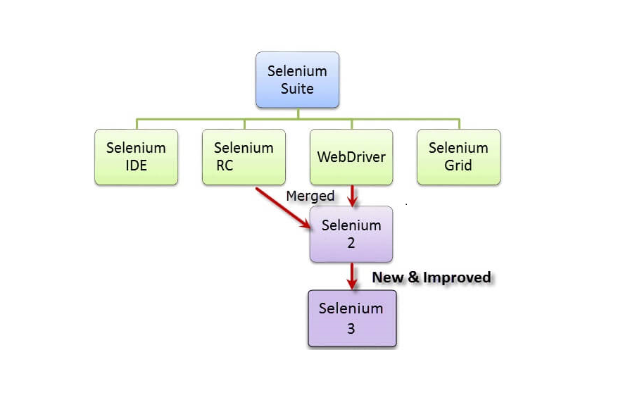
Types or Components of Selenium
Selenium Integrated Development
Environment (IDE)
Selenium Remote Control (RC)
WebDriver
Selenium Grid

Slide 6
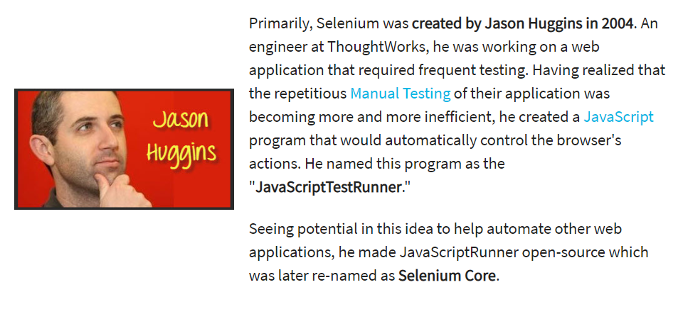
Who Developed Selenium?

Slide 7
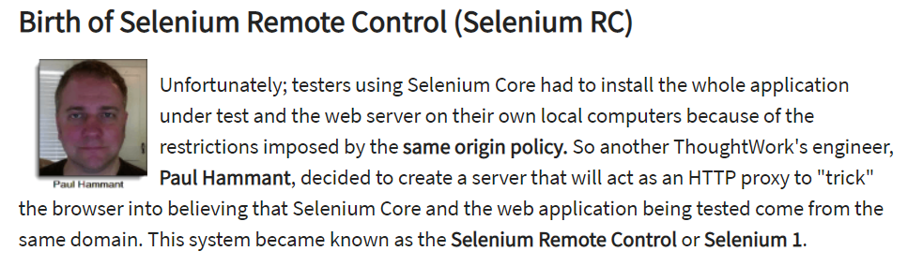
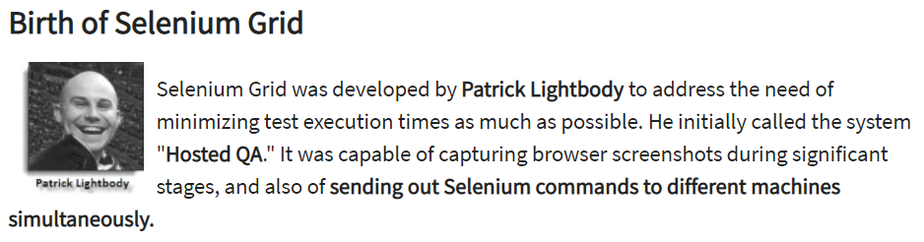

Slide 8
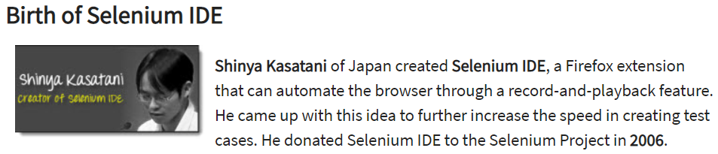
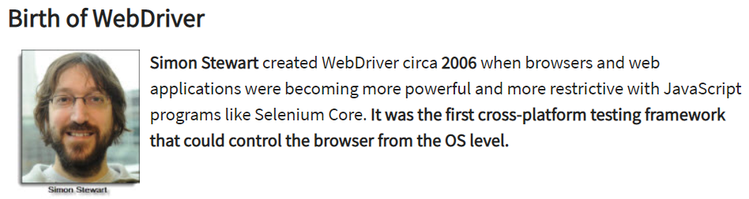

Slide 9
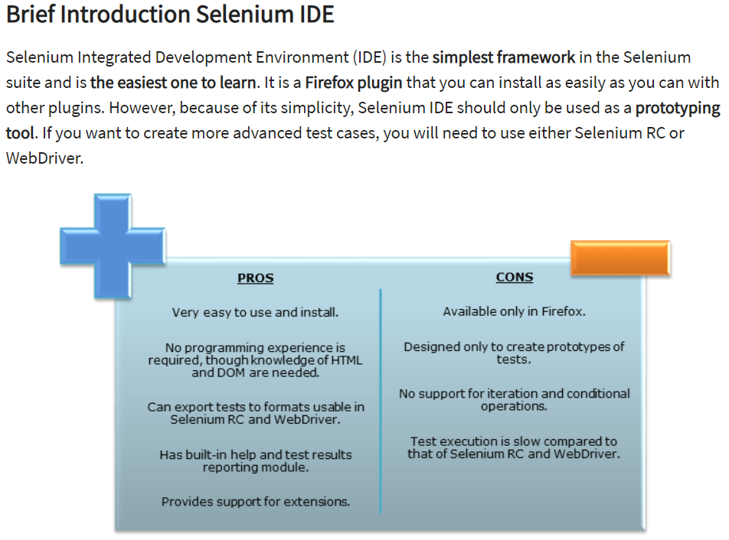

Slide 10
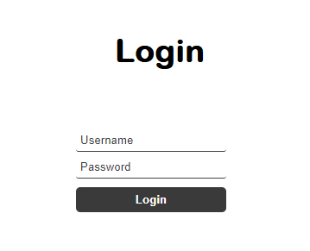
How it works..
1
Identify web elements
(by using identifiers)
2
Add Actions
(by using preferred programming language)
Input
Test
Data
Click
3
Run the test

Slide 11
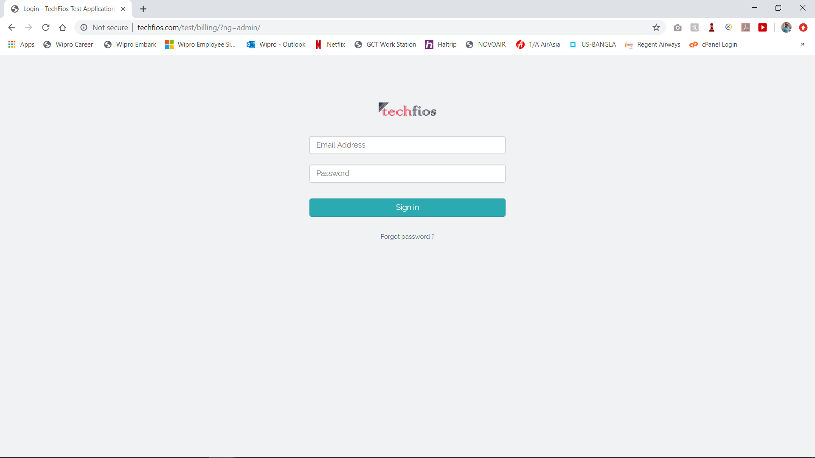
Techfios Testing Website
Web Link: https://codefios.com/ebilling/
User Name: demo@techfios.com
Password: abc123

Slide 12
Demo Test Cases
TC No | TC Name | Test Steps | Expected Result | Actual Result | Pass/Fail
2004-1 | Login Test | Open Chrome | Chrome should Open | Chrome opened
 |  | Go to Techfios Website | Should be able to go to Website | Website displayed
 |  | Provide Username | User name should typed in the box | Username typed
 |  | Provide Password | Password should typed in the box | Password typed
 |  | Click in the Sign In button | Sign In button should be clicked | Sign In button clicked
 |  | Display Home page | Home page should display | Home page Displayed

Slide 13
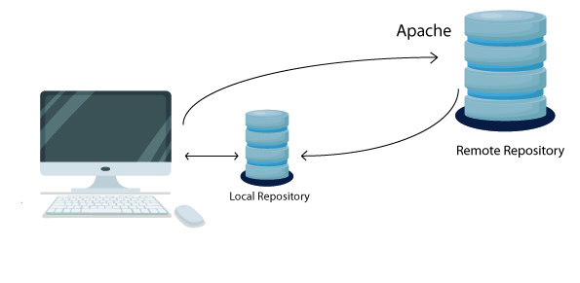
What is Maven?
Maven is a project management and comprehension tool that provides developers a complete build lifecycle framework.
It is used to build and manage primarily Java projects. But also can be used with other languages.
Maven Dependency:
Dependency is an archive of JAR, which
current project needs to compile, build
and run. Dependencies are gathered in
the POM.
Link: https://mvnrepository.com/

Slide 14
Maven Lifecycle
validate - validate the project is correct and all necessary information is available
compile - compile the source code of the project
test - test the compiled source code using a suitable unit testing framework. These tests should not require the code be packaged or deployed
package - take the compiled code and package it in its distributable format, such as a JAR.
verify - run any checks on results of integration tests to ensure quality criteria are met
install - install the package into the local repository, for use as a dependency in other projects locally
deploy - done in the build environment, copies the final package to the remote repository for sharing with other developers and projects.

Slide 15
.xml Structure
Opening Tag
<properties>
<project.build.sourceEncoding>UTF-8</project.build.sourceEncoding>
</properties>
<dependencies>
<dependency>
<groupId>junit</groupId>
<artifactId>junit</artifactId>
<version>3.8.1</version>
<scope>test</scope>
</dependency>
</dependencies>
Closing Tag
Opening Tag Structure
< >
Closing Tag Structure
</ >
Opening Tag
Closing Tag

Slide 16
What is JUnit..
JUnit is a unit testing framework for Java programming language.
@Test :
It is called Annotation
This annotation tells JUnit to run the public void method to which it is attached.
Annotations:
@BeforeClass – Run once before any of the test methods in the class
@Before – Run before @Test
@Test – This is the test method to run
@After – Run after @Test
@AfterClass – Run once after all the tests in the class have been run

Slide 17
close() vs quit()
close() method shall close the browser which is in focus.
close() method closes the active WebDriver instance.
quit() method closes all the browsers.
quit() method closes all the active WebDriver instances.

Slide 18
Homework
Automate the following test case:
Scenario: Users will be able to add deposit
1: Open Browser and go to site http://www.techfios.com/billing/?ng=admin/
2. Enter username: demo@techfios.com
3. Enter password: abc123
4. Click login button
5. Click on Bank & Cash button
6. Click on New Account button
7. Fill out the Add New Account form
8. Click on submit button
9. Visually check if the account has been created
Visually check to make sure the deposit posted

